Slide 1
Slaughter Facility
USDA vs. State Inspected
Vacuum Seal vs. Shrink Wrap vs. Paper Wrap
Cut Specifications & Terminology
Inventory & Pick Up Packaging

Slide 2
Know Your Cost of Goods
Cost of Live Animal
Current Commodity Market Price
All costs associated with Slaughter & Packaging
Overhead Costs
Custom Labels
Insurance
Stall Fees, if applicable
Storage/Utilities
Mileage/Fuel/etc.

Slide 3
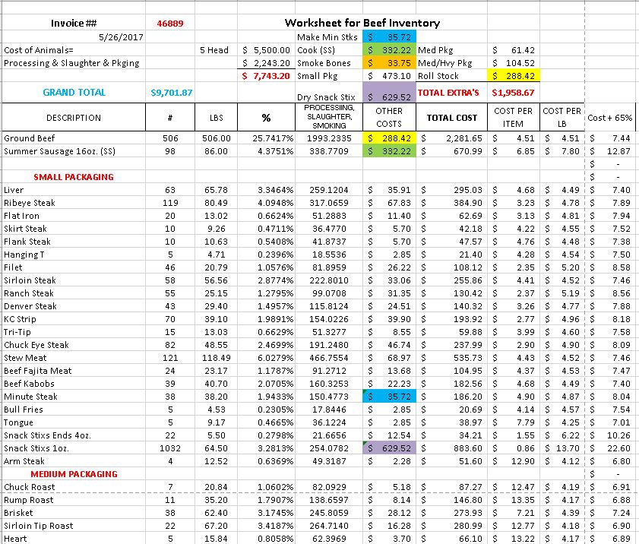

Slide 4
Bulk Sales vs. By the Cut
Know your Cost of Goods
Storage Capacity
Ability to Accept Electronic Payments
Sustainability

Slide 5
Farmers Market Do’s & Don’t’s
Do
1. Know your Products
2. Know your Customers
3. Easy to Read Signage
4. Elevator Speech
Don’t
Be negative about anything
Discuss Religion, Guns or Politics--EVER
Make it difficult to buy from you

Slide 6
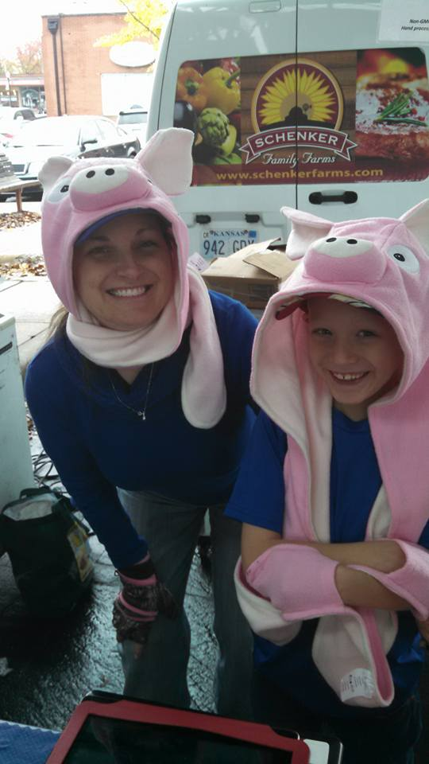
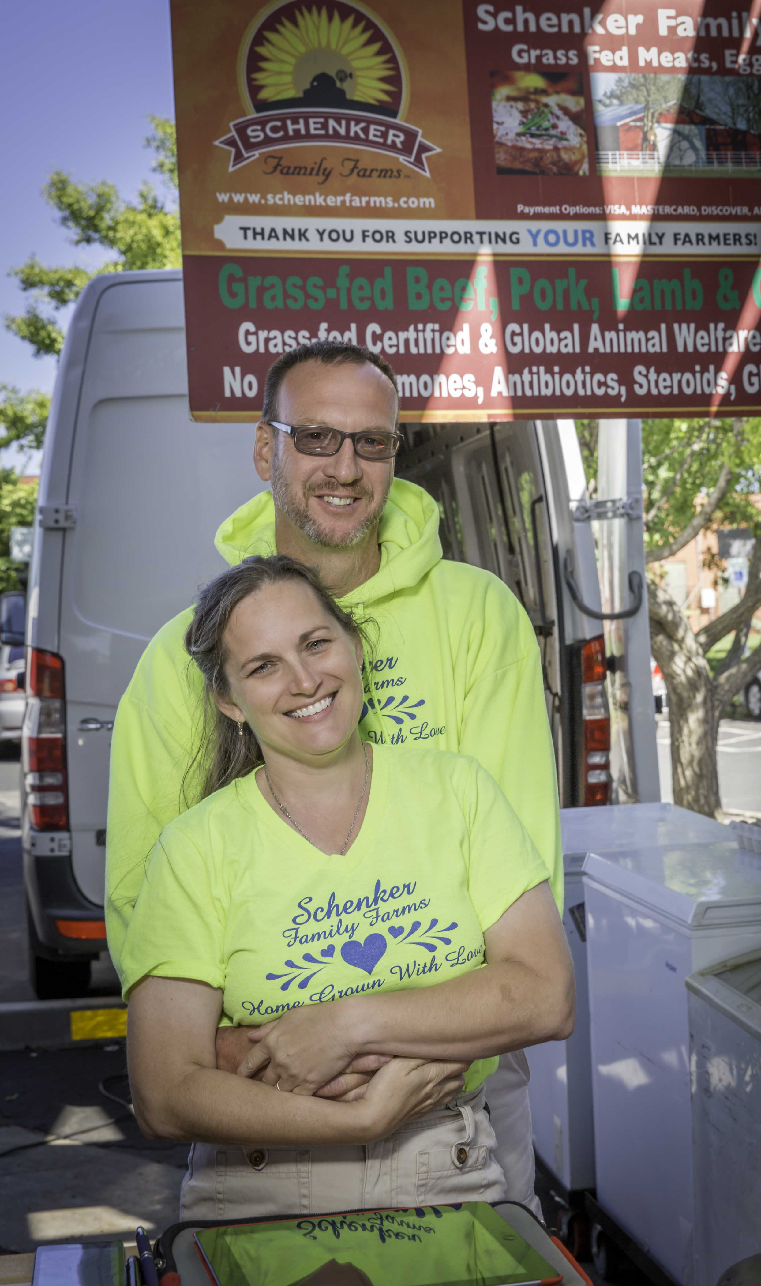

Slide 7
Customer Service
How to Approach the Problem
Responding to Social Media Issues
Dealing with Unrealistic Expectations
Being Proactive
Recipe Cards
Recipe Blog
Helping the customer choose the best cut

Slide 8
Top Take A Ways
You are Selling More than Meat…You are Selling American Agriculture & Educating Eaters in the Process
Know Your Cost of Goods
Your Time is Valuable—Make it Count!
Do Not Let Your Business Consume You

